Slide 1
E-Security

Slide 2
Learning objectives
Definition of E-Security
Good E-Commerce Security
Security Threat in E-Commerce
Dimensions of E-Commerce E-Security
Technology Solutions to Security Threat

Slide 3
E-SECURITY (ONLINE SECURITY)
The cyberwar is a reality; the Internet and Web are increasingly vulnerable to large-scale attacks and potentially large-scale failure.
Led by organized gangs of criminals operating globally- an unintended consequence of globalization.
However, there are steps you can take to protect your Web sites and your personal information when using e-commerce sites.

Slide 4
The E-commerce Security Environment
For most law-abiding citizen, the Internet holds the promise of a huge, convenient, global market place, providing access to people, goods, services, and businesses worldwide.
For criminals, the Internet has created entirely new- and lucrative – ways to steal from more than 1 billion consumers in the world on the Internet. From products and services to cash information, it’s all there for the taking on the Internet.
It is less risky to steal on the Internet. Rather than rob a bank in person, the Internet makes it possible to rob people remotely and almost anonymously.

Slide 5
The E-commerce Security Environment Cont.
The Internet was never designed to be a global marketplace with a billion users, and lacks many basic security features found in older networks such as telephone system.
The Internet is an open, vulnerable-design network.
Reducing risks in e-commerce is a complex process that involves new technologies, organizational policies and procedure, and new laws and industry standards that empowers law enforcement officials to investigate and prosecute offenders.

Slide 6
Dimensions of E-Commerce Security
There are six dimensions to e-commerce security: integrity, nonrepudiation, authenticity, confidentiality, privacy and availability.
Integrity
Integrity refers to the ability to ensure that information being displaced on a Web site, or transmitted or received over the Internet, has not been altered in any way by an unauthorized party.

Slide 7
Dimensions of E-Commerce Security Cont.
Authenticity
Authenticity refers to the ability to identify the identity of a person or entity with whom you are dealing on the Internet.
Availability
Availability refers to the ability to ensure that an e-commerce site continues to function as intended.

Slide 8
Dimensions of E-Commerce Security Cont.
Confidentiality
Confidentiality refers to the ability to ensure that messages and data are available to only those who are authorized to view them. Confidentiality is sometimes confused with privacy, which refers to the ability to control the use of information a customer provides about himself or herself to an e-commerce merchant.

Slide 9
Dimensions of E-Commerce Security Cont.
E-commerce merchants have two concerns related to privacy.
They must establish internal policies that govern their own use of customer information, and
They must protect that information from illegitimate or unauthorized use.
Nonrepudiation
Nonrepudiation refers to ability to ensure that e-commerce participants do not deny (i.e. repudiate) their online actions.

Slide 10
Customer and Merchant perspectives on the different dimensions of e-commerce security
Dimensions | Customer’s Perspective | Merchant’s Perspective
Integrity | Has information I transmit or receive been altered? | Has data on the site been altered without authorization? Is data being received from customers valid?
Nonrepudiation | Can party to an action with me later deny taking the action? | Can a customer deny ordering products?
Authenticity | Who am I dealing with? How can I be assured that the person or entity is who they claim to be? | What is the real identity of the customer?
Confidentiality | Can someone other than the intended recipient read my messages? | Are messages or confidential data accessible to anyone other than those authorized to view them?
Privacy | Can I control the use of information about myself transmitted to an e-commerce merchant? | What use, if any, can be made of personal data collected as part of an e-commerce transaction? Is personal information of customers being used in an unauthorized manner?
Availability | Can I get access to the site? | Is the site operational?

Slide 11
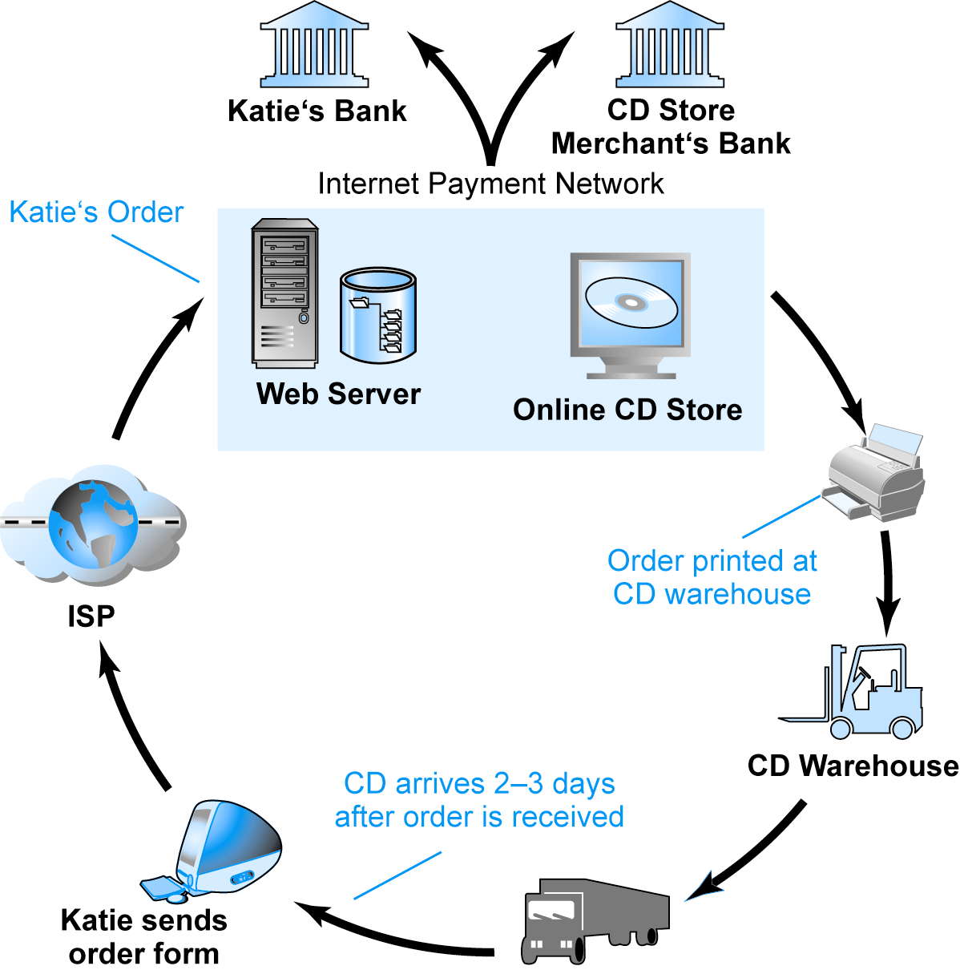
Security Threats in the E-commerce Environment
There are three key points of vulnerability:
client,
Server
communication pipeline.
Figure 1: A Typical E-commerce Transaction

Slide 12
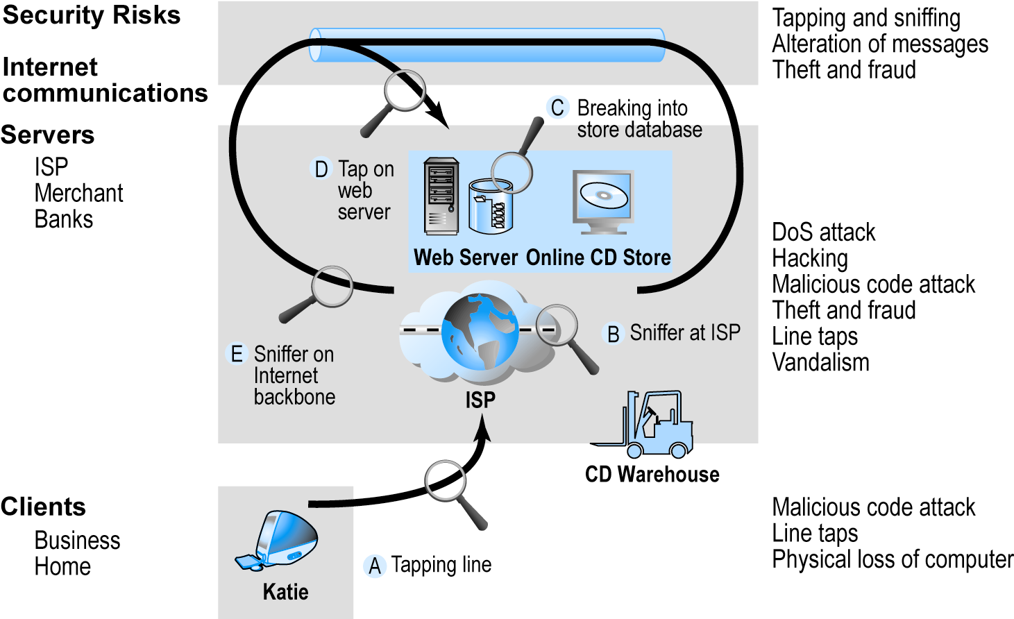
Vulnerable Points in an E-commerce Environment
SOURCE: Boncella, 2000.

Slide 13
Most Common Security Threats in the E-commerce Environment
Malicious code (sometimes referred to as ‘malware’)
Viruses
Worms
Trojan horses
Bots, botnets
Unwanted programs
Browser parasites: program that can monitor and change the settings of a user’s browser.
Adware: is used to call for pop-up ads to display when the user visits certain sites.
Spyware can be used to obtain information such as a user’s keystrokes, copies of e-mail and instant messages, and even take screenshots, thereby capture passwords or other confidential data.
Notes:
Recent virus distribution is to embed them in the online advertising chain, including Google and other ad hoc networks. For instance, 2007, Google users who clicked on Tomshardware.com were re-directed to a server that download viruses and destroyed computers

Slide 14
Computer virus fall into several major categories as follows:
Macro viruses are application-specific, meaning the virus affects only the application for which it was written, such as Microsoft Word, Excel or PowerPoint.
Macro viruses often distributed by sending e-mail attachment.
File-infecting viruses usually affect executable files, such as *.com, *.exe, *.drv, and *.dll files.
Scrpt viruses are written in script languages such as VBScript and JavaScript. The viruses are activated simply by double-clicking an infected *.vbs or *.js file.
Worm is designed to spread from computer to computer instead of file to file.

Slide 15
Most Common Security Threats
Phishing
Deceptive online attempt to obtain confidential information
Social engineering, e-mail scams, spoofing legitimate Web sites
Use information to commit fraudulent acts (access checking accounts), steal identity
Hacking and cybervandalism
Hackers vs. crackers: A hacker is an individual who intends to gain unauthorized access to a computer system.
Cybervandalism: intentionally disrupting, defacing, destroying Web site
Types of hackers: white hats, black hats, grey hats

Slide 16
Security Threats in the E-commerce Environment Cont.
White hats are hackers who breaks into the system with the intent of helping to discover security flaws. White hats do their work under contract, with agreement from client that they will not be prosecuted for their efforts to break in.
Black hats are hackers who engage in the same kind of activities but without pay or any buy-in from the targeted organization and with intention of causing harm.
Grey hats, hackers who believe they are pursuing some greater good by breaking in and revealing system flaws. Grey hats discover weaknesses in a system’s security, and then publish the weakness without disrupting the site or attempting to profit from their findings.
Their only reward is prestige of discovering the weakness.

Slide 17
Most Common Security Threats
Credit card fraud/theft
Fear of stolen credit card information deters online purchases
Hackers target merchant servers; use data to establish credit under false identity
Online companies at higher risk than offline
Spoofing: misrepresenting self by using fake e-mail address
Pharming: spoofing a Web site
Redirecting a Web link to a new, fake Web site
Spam/junk Web sites
Splogs
Notes:
spoofing attack is a situation in which a person or program successfully masquerades as another by falsifying data, to gain an illegitimate advantage

Slide 18
Most Common Security Threats
Denial of service (DoS) attack
Hackers flood site with useless traffic to overwhelm network
Distributed denial of service (DDoS) attack
Hackers use multiple computers to attack target network
Sniffing
Eavesdropping program that monitors information traveling over a network
Insider jobs
Single largest financial threat e.g. embezzlement by insiders is also true for e-commerce sites, destruction to sites, and diversion of customer credit data and personal information
Poorly designed server and client software
Notes:
When use legitimately, sniffers can help identify potential network trouble-spot, but when used for criminal purposes, they can be damaging and very difficult to detect.

Slide 19
Technology Solutions
There are two lines of defense of e-commerce security: technology solutions and policy solutions.
Technology solution can be categorized into:
Protecting Internet communications (encryption)
Securing channels of communication (SSL, S-HTTP, VPNs)
Protecting networks (firewalls)
Protecting servers and clients
Access controls
Authentication
Instruction detection
Proxy/agent systems
Security management

Slide 20
Encryption
Encryption
Transforms data (plain text) into cipher text readable only by sender and receiver
The purpose is to secures stored information and information transmission
It provides 4 of 6 key dimensions of e-commerce security:
Message integrity
Nonrepudiation
Authentication
Confidentiality

Slide 21
Symmetric Key Encryption
Sender and receiver use same digital key to encrypt and decrypt message
Requires different set of keys for each transaction
Strength of encryption
Length of binary key used to encrypt data
Advanced Encryption Standard (AES)
Most widely used symmetric key encryption
Uses 128-, 192-, and 256-bit encryption keys
Other standards use keys with up to 2,048 bits

Slide 22
Public Key Encryption
In 1976, a new way of encrypting messages called public key cryptography was invented by Whitefield Diffie and Martin Hellman.
It solves the problems of exchanges keys. Uses two mathematically related digital keys
Public key (widely disseminated)
Private key (kept secret by owner)
Both keys are used to encrypt and decrypt message
However, once a key used to encrypt message, same key cannot be used to decrypt message
Sender uses recipient’s public key to encrypt message; recipient uses his/her private key to decrypt it.

Slide 23
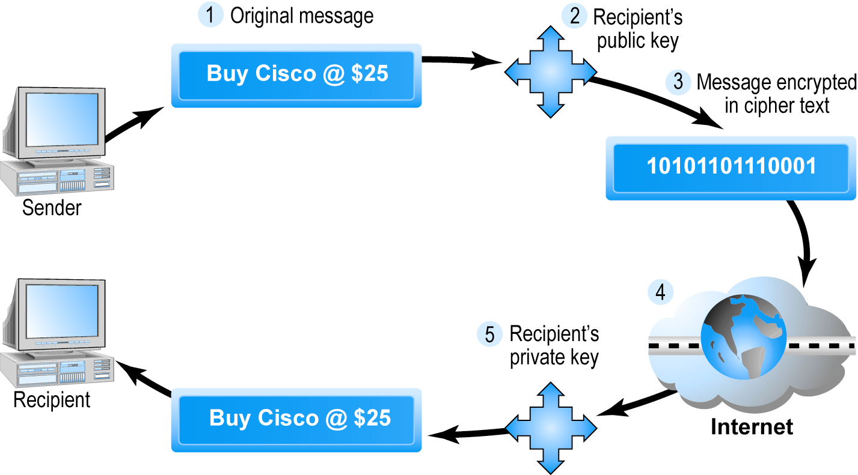
Public Key Cryptography—A Simple Case

Slide 24
Public Key Encryption
In public key encryption, some important features of security are missing. Although the message sent can be guaranteed that it was not accessed by third party (message confidentiality), there is no guarantee that the sender is really the sender because there is no authentication.
This means the sender can deny ever sending any message (repudiation) and
There is no assurance the message was not altered in transit. This point out lack of security in the public key encryption.

Slide 25
Public Key Encryption Using Digital Signatures and Hash Digests
A more sophisticated public key cryptography that can achieve authentication, nonrepudiation, and integrity.
Hash function:
Mathematical algorithm that produces fixed-length number called message or hash digest
Hash digest of message is sent to recipient along with message to verify its integrity
The sender encrypts hash digest and message with recipient’s public key.

Slide 26
Public Key Encryption Using Digital Signatures and Hash Digests
To ensure the authenticity of the message and nonrepudiation of the message, the sender encrypts the entire block of cipher text one more time using the sender private key.
This produces a digital signature also called e-signature or ‘signed’ cipher text that can be sent over the Internet.
A digital signature is close to hand written signature because the private key is unique to individual. When the private key is used with hash function, the digital signature is even more unique than a hand written signature.

Slide 27
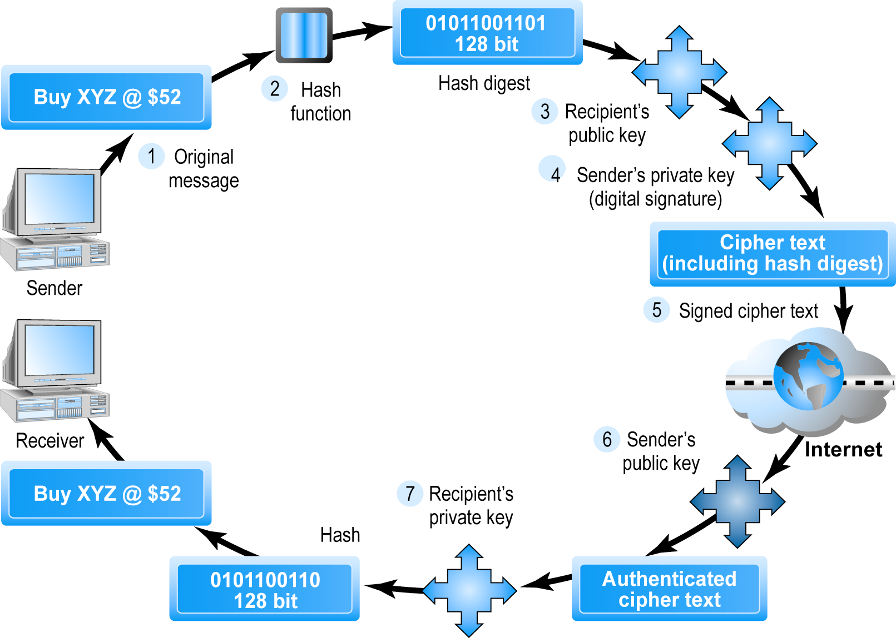
Public Key Cryptography with Digital Signatures

Slide 28
Public Key Encryption Using Digital Signature and Hash Digests Cont
The recipient of this signed cipher text uses the sender’s public key to authenticate the message. Once authenticated, the recipient uses his or her private key to obtain the hash result and the message.
Finally, the recipient applies the same hash function to the original message and compares the result with result sent by the sender.
If the same result is obtained, the recipient is sure that the message has not been altered during transmission. The message has integrity.

Slide 29
Digital Envelopes
Addresses weaknesses of:
Public key encryption
Computationally slow, decreased transmission speed, increased processing time
Symmetric key encryption
Insecure transmission lines
Uses symmetric key encryption to encrypt document
Uses public key encryption to encrypt and send symmetric key
Notes:
Public key encryption is computationally slow. Symmetric key encryption is computationally faster, but has a weakness of symmetric key must be sent to recipient over insecure transmission lines.
An efficient way to provide a solution is to use symmetric key encryption and decryption for a large document and use the public key encryption to encrypt and send the symmetric key. This technique is called using a digital envelope.

Slide 30
Digital Envelopes Cont.
For instance, a document is encrypted using a symmetric key.
The symmetric key which the recipient will need to decrypt the document is also encrypted using the recipient’s public key. The encrypted report and the digital envelopes are sent across the web.
The recipient first use his or her private key to decrypt the symmetric key, and subsequently use the symmetric key to decrypt the report.
This method saves time because both encryption and decryption are faster with symmetric key.

Slide 31
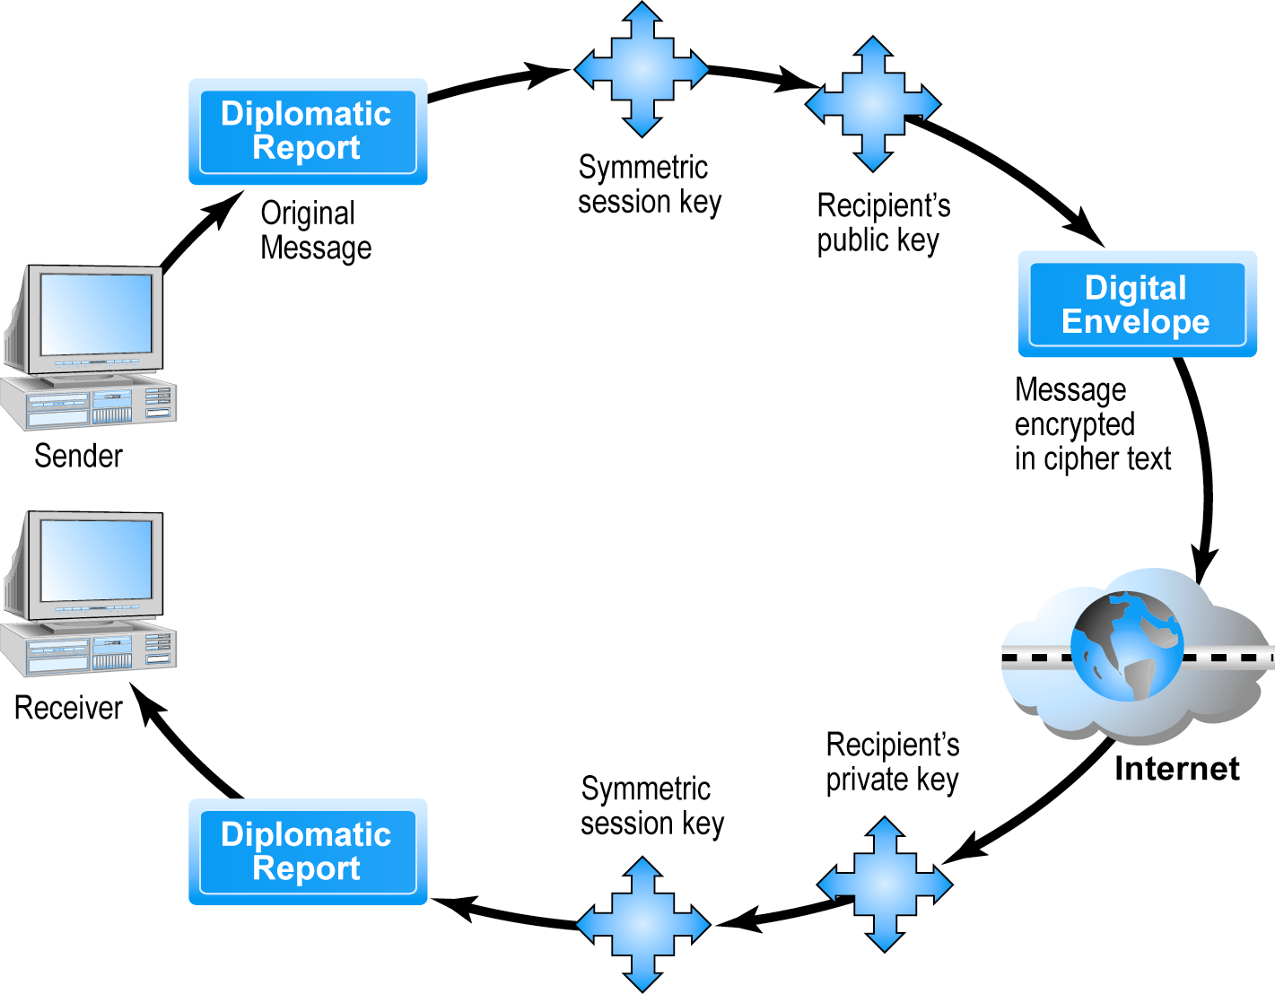
Creating a Digital Envelope
Figure 5.10, Page 293

Slide 32
Digital Certificates and Public Key Infrastructure (PKI) Cont.
Digital certificates and the supporting public key infrastructure, are an attempt to solve the problem of digital identity.
A digital certificate is a digital document issued by a trusted third party institution known as a certification authority (CA)
Digital certificate includes:
Name of subject/company
Subject’s public key
Digital certificate serial number
Expiration date, issuance date
Digital signature of certification authority (trusted third party institution) that issues certificate
Public Key Infrastructure (PKI):
CAs and digital certificate procedures that are accepted by all parties

Slide 33
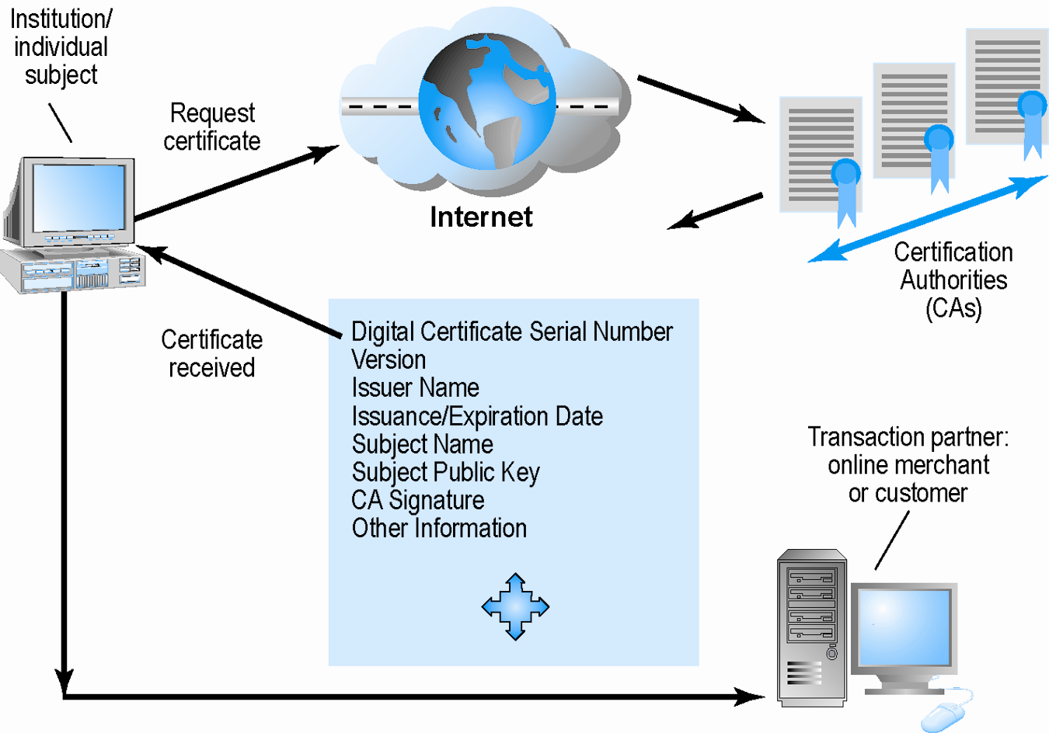
Digital Certificates and Certification Authorities
Figure 5.11, Page 294

Slide 34
Limits to Encryption Solutions
Doesn’t protect storage of private key
PKI not effective against insiders, employees
Protection of private keys by individuals may be haphazard
No guarantee that verifying computer of merchant is secure
CAs are unregulated, self-selecting organizations

Slide 35
Insight on Society In Pursuit of E-mail Security Class Discussion
What are some of the current risks and problems with using e-mail?
What are some of the technology solutions that have been developed?
Are these solutions compatible with modern law?
Consider the benefits of a thorough business record retention policy. Do you agree that these benefits are worth giving up some control of your e-mail?

Slide 36
Securing Channels of Communication
Secure Sockets Layer (SSL):
Establishes a secure, negotiated client-server session in which URL of requested document, along with contents, is encrypted
S-HTTP:
Provides a secure message-oriented communications protocol designed for use in conjunction with HTTP
Virtual Private Network (VPN):
Allows remote users to securely access internal network via the Internet, using Point-to-Point Tunneling Protocol (PPTP)

Slide 37
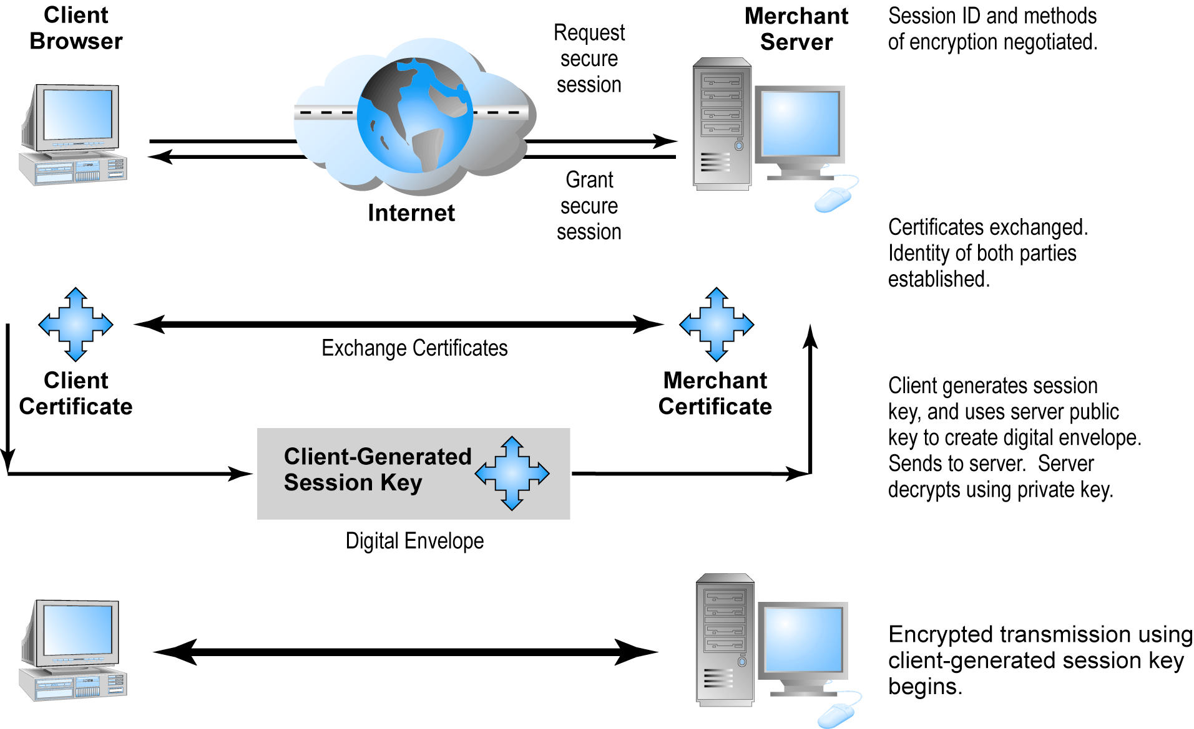
Secure Negotiated Sessions Using SSL

Slide 38
Protecting Networks
Firewall
Hardware or software that filters packets
Prevents some packets from entering the network based on security policy
Two main methods:
Packet filters
Application gateways
Proxy servers (proxies)
Software servers that handle all communications originating from or being sent to the Internet

Slide 39
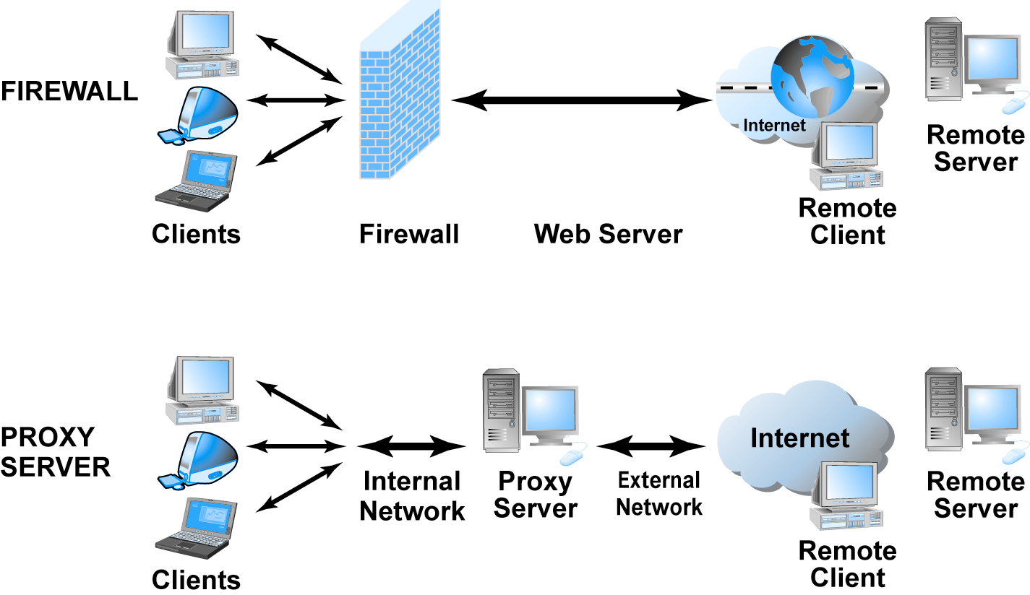
Firewalls and Proxy Servers

Slide 40
Protecting Servers and Clients
Operating system security enhancements
Upgrades, patches
Anti-virus software
Easiest and least expensive way to prevent threats to system integrity
Requires daily updates

Slide 41
A Security Plan: Management Policies
Risk assessment
Security policy
Implementation plan
Security organization
Access controls
Authentication procedures, including biometrics
Authorization policies, authorization management systems
Security audit

Slide 42
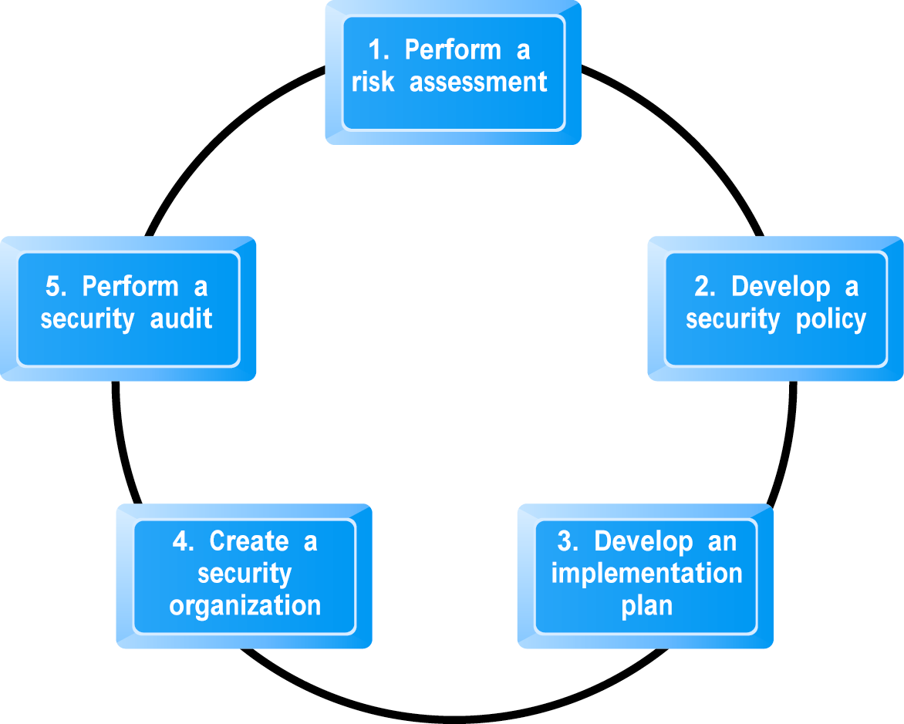
Developing an E-commerce Security Plan

Slide 43
The Role of Laws and Public Policy
Laws that give authorities tools for identifying, tracing, prosecuting cybercriminals:
National Information Infrastructure Protection Act of 1996
USA Patriot Act
Homeland Security Act
Private and private–public cooperation
CERT Coordination Center
US-CERT
Government policies and controls on encryption software
OECD guidelines

Slide 44
Assignment
What is LOCKSS? What are the advantages and disadvantages to LOCKSS
Write a page note on Information Infrastructure Protection Act in Nigeria

